Slide 1

CAN/Elevator Diagnostic Control Project
By Ovi, James & Kevin

Slide 2

Overview
Phase I
Develop elevator system nodes with CAN communication
Floor Nodes
Car-Controller Node
Elevator Supervisor
Phase II
Develop a web based user interface for a logging & control
Phase III
Integrate phase 1 and 2 together
Control elevator from website and from individual nodes

Slide 3

PHASE I
Outcome: Fully functioning CAN network

Slide 4
Phase I: Work Distribution
KEVIN
Project Schedule
Test Plan
Linux Supervisor Software
JAMES
System Block Diagram
Axman send/receive via CAN
Car-Controller Software & Hardware configuration
OVI
Project Constraints
Axman send/receive via CAN
Elevator Nodes Software & Hardware configuration

Slide 5

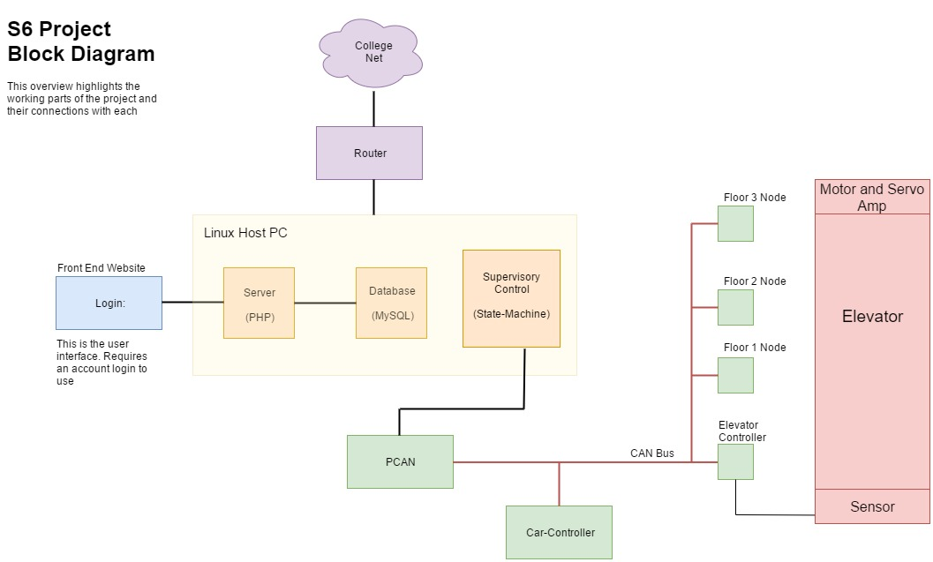
Phase I
System Block Diagram

Slide 6
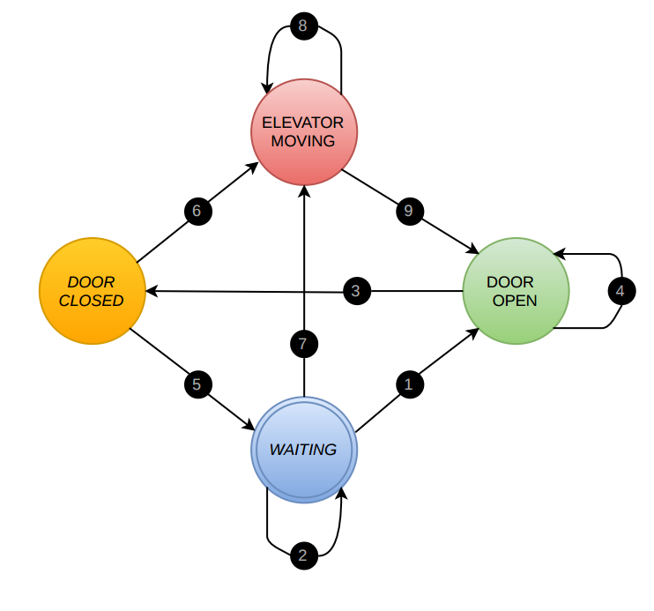
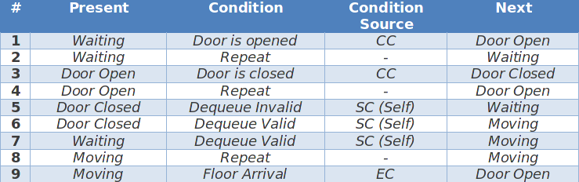
Linux Supervisor
Key Components:
Main application loop:
Four States: Waiting, Door Open, Door Closed, Moving
Six Conditions: (1) Door is opened (2) Door is closed
(3) Dequeue valid (4) Dequeue invalid
(5) Floor arrival (6) Repeat (no change)
Read CAN bus
Read database
Step through State Machine

Slide 7
PHASE II
Outcome: Website with elevator control interface

Slide 8
Phase II: Work Distribution
KEVIN
Handle user requests from database
Home page design
JAMES
Control UI
Writing user requests to database tables
OVI
Read from database to produce live status updates
Project schedule

Slide 9
PHASE III
Outcome: Fully Integrated CAN Network with Remote and Diagnostic Control

Slide 10
THANKS!
Any questions?

